Slide 1


micro:bit entry video tutorial
Lesson 2
micro:bit basic lesson 2 “See who is pressing fast”
YahBoom micro:bit video tutorial

Slide 2
micro:bit entry video tutorial
Content
Part1
Part 2
Part3
Part 4
Part 5
Learning goals
Preparation
Search for blocks
Combine blocks
Have a try
YahBoom micro:bit video tutorial

Slide 3
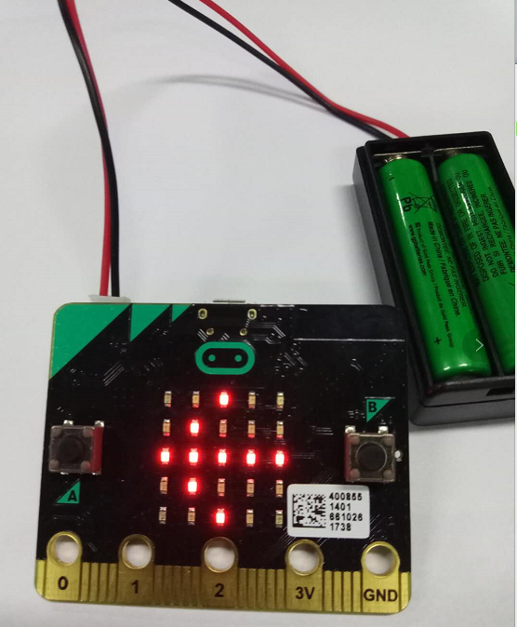
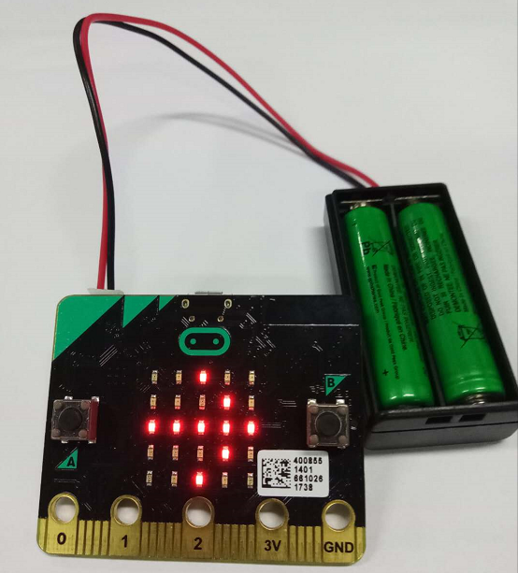
micro:bit entry video tutorial
Part 1
Learning goals
When you download a good program, call your little partner to play. One is standing on the A key, and the other is standing on the B button. And then you count down 3,2,1 and press the button together. If the A button is pressed first, there will be an arrow pointing to the A button on the dot matrix. If the B button is pressed first, there will be an arrow pointing to the B button on the dot matrix. If it is pressed at the same time, it will show a love on the dot matrix.
YahBoom micro:bit video tutorial

Slide 4
micro:bit entry video tutorial
Part 2
Hardware:
● 1 X Micro: bit Board
● 1 X Micro USB Cable
● 2 X AAA batteries
Preparation
Then the micro:bit is connected to the computer through USB, and the computer will pop up a U disk and click the URL in the U disk to enter the programming interface.
YahBoom micro:bit video tutorial

Slide 5
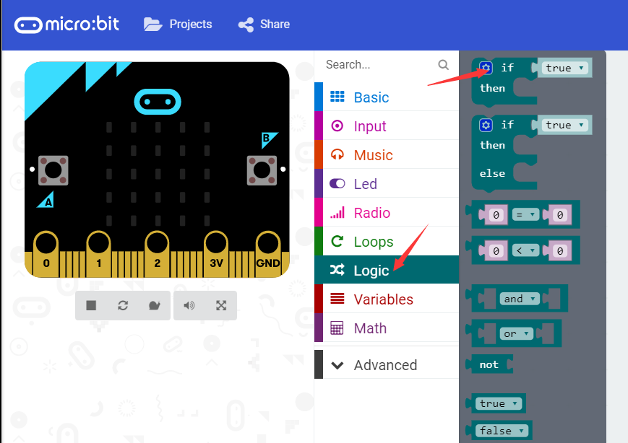
micro:bit entry video tutorial
Part 3
Search for blocks
YahBoom micro:bit video tutorial

Slide 6
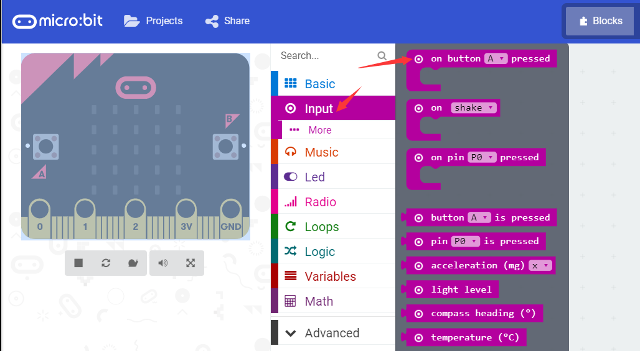
micro:bit entry video tutorial
Part 3
Search for blocks
YahBoom micro:bit video tutorial

Slide 7
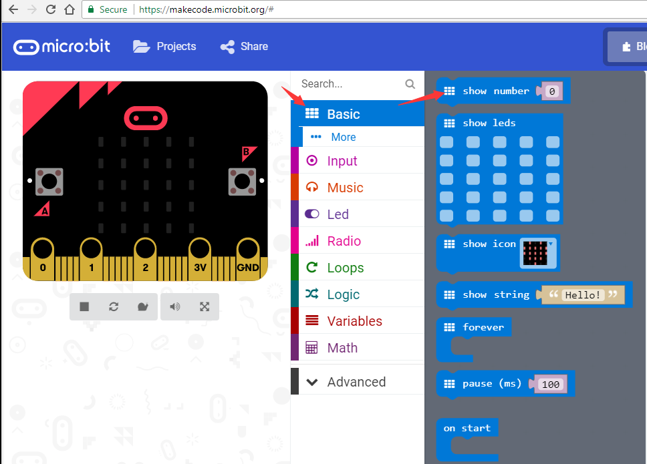
micro:bit entry video tutorial
Part 3
Search for blocks
YahBoom micro:bit video tutorial

Slide 8
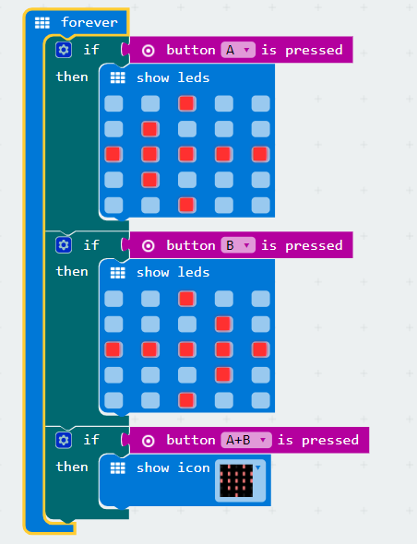
micro:bit entry video tutorial
Part 4
Combine blocks
YahBoom micro:bit video tutorial

Slide 9


micro:bit entry video tutorial
Part 5
Do you learn the course today?
If you learn to do it, give yourself a top quack.
Now give you a homework assignment.
On the micro:bit dot matrix, press the A button, the heart starts to beat, press the B button, and the heart stops beating. You can relate the content of this lesson to the first lesson.
Start your little brain. Try it.
Have a try
YahBoom micro:bit video tutorial

Slide 10
micro:bit entry video tutorial
micro:bit
project
Thanks for watching！
Powered by YahBoom
YahBoom Micro:bit video tutorial

